Slide 1


Slide 2
What is it?
Sahi is a free open source test automation tool for web applications.
A free version provides key testing functionality with a payed version giving extended features for companies.

Slide 3
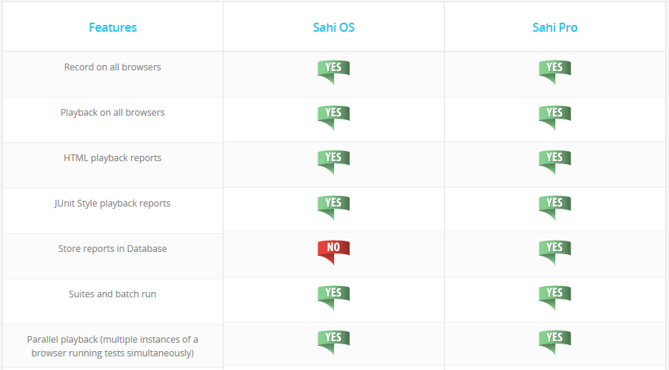
What is it?

Slide 4
What is it?
Currently a single user licence can be purchased for $695 per year with percentage discounts for groups. Other payed features are as follows:
Distribute tests across machines
Anchor Button on Controller to easily establish “near” and “in” relations
View recorded steps in Controller
Script Editor to easily create functions
Excel Framework
Custom report generation
Take Snapshots
Side by Side Compare Logs
Flex automation
Automatically accept SSL certificates
Ability to build repository of HTML Elements while recording

Slide 5
What is it?
Similar to another testing tool called selenium, Sahi automates the behaviour of a web browser through user events like clicking and typing in some text.
The tool can then check the data in the website to make sure that the outcome of the actions is as expected through assertions.

Slide 6
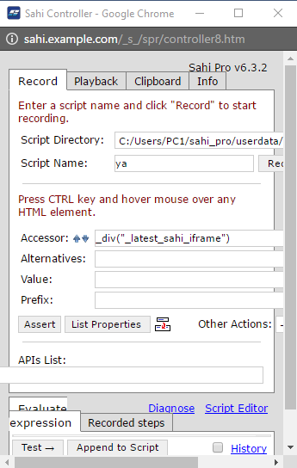
What is it?
The key functionality of simulating a user’s actions and recording the actions.
This works well with an emphasis on functionality rather than on a good looking resizable interface.
The interface of Sahi in the browser will become skewed for example if it is resized.

Slide 7
What is it?
Selenium is a much more popular testing tool of this type with a larger community for support.
Users have reported that Sahi performs faster and with less problems for browsers in particular IE.
The advantage of using Sahi is in not having to explicitly install a browser driver plugin.
Sahi provides less free feature compared to its competitors, which is not a fair comparison of usability and functionality.

Slide 8
What is it?
The installation in Windows is straight forward. After downloading the software, a licence key is emailed, to be entered when it is first run.
Sahi runs as a Java application that opens a private browsing window for testing.

Slide 9
How Does it Work?
Sahi is best suited for multi-browser testing that contain AJAX and dynamic content. Sahi can run on any browser that supports JavaScript.
AJAX stands for Asynchronous JavaScript and XML. AJAX is a new technique for creating interactive, dynamic web applications using XML, HTML, CSS and JavaScript.

Slide 10
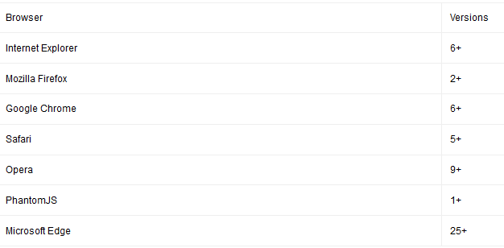
How Does it Work?

Slide 11
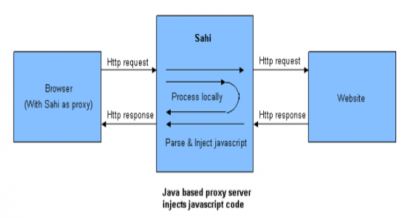
How Does it Work?
Sahi’s core features include the Sahi proxy and the JavaScript Engine.

Slide 12
How Does it Work?
HTML responses that pass through the proxy are amended so that JavaScript is injected at the start and the end of the response.
This process then allows the chosen browser to record and playback scripts and talk back to the proxy when needed.
Basically, the process above keeps track of all the communication occurring which can be later referred to if needed by the browser.

Slide 13
How Does it Work?
The scripts can be written in any text editor!
So scripts are all based on JavaScript but each script is parsed by Sahi i.e. some modifications added and script saved as .SAH file.
Using these scripts we can write anything that JavaScript is capable of as Sahi inherits every possibility from JavaScript e.g. functions.

Slide 14
How Does it Work?
The user can also add assertions, which are added to the script.
Assertions are used for verification.
This is where the user specifies which path or what should be the correct outcome.

Slide 15
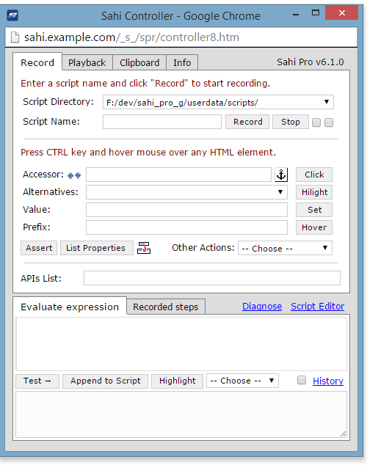
How Does it Work?

Slide 16
How Does it Work?
Step by step execution;
Record actions on the webpage
Modify script adding assertions, functions etc.
Stop recording. Script saved.
Run playback of the script
Sahi generates a log which displays some useful information along with either pass or fail of each action.

Slide 17
Mini-Exercise

Slide 18
Strengths and Weaknesses
Easy to set up :Open source tool therefore it is available to everyone. When downloading it no additional tools are required . Tests run from the Sahi controller/command line.
Efficiency- Sahi has made the testing process more efficient. It handles the repetitive, time consuming tests and it allows the team to focus on the tricky ones. This process allows the team to be more efficient therefore saving time and money and also generate a high ROI.
Consistent Platform : Sahi has the ability to run on all browsers. This reduces the number of errors in the testing scenario by going through pre-recorded instructions. Sahi scripts are fast to create and very easy to maintain

Slide 19
Strengths and Weaknesses
Support for multiple languages: SAHI uses Javascript as its base language. Currently SAHI does not let you create your test cases in other language.
Sahi application runs separate from the record window.
Browser has to be configured to work with a proxy.

Slide 20
Questions?

Slide 21
Team Members
Aleksander Zoric
Liranda Krisniski
Chris O’Brien
James McGarr

